Slide 1
Machine Learning:
Application Project
Project Members: Ajwa Shahid (ckf2dq),
Ji Hyun Kim (mqa4qu), Nicki Choquette (nc2uzv)

Slide 2
Data Processing
For the project3_dataset1, and project3_dataset2 we separated the features from the labels.
For the dataset2 we mapped the fourth column from the features such that the “Absent” is 0 and “Present” is 1.
Normalized both the datasets to avoid any scaling issue.

Slide 3
Table Of Contents
Logistic Regression
K Nearest Neighbor
Decision Tree
SVM
Random Forest
Boosting
Neural Network

Slide 4
Logistic Regression
The first classification model we implemented that utilizes features and weights for each along with a bias to correctly classify a datapoint with highest probability.
Parameter Tuning
Strong regularization effect will give less accurate results since the model would then overfit on the training data and perform poorly on the tests data. So, for our model we decided to test out different regularization values by changing the C parameter (the inverse of regularization strength). A higher value of C would mean minimal regularization, and vice versa.
C (Inverse of Regularization Strength)
Range of values tested: [ '0.001', '0.01', '0.1', '1', '10', '100']

Slide 5
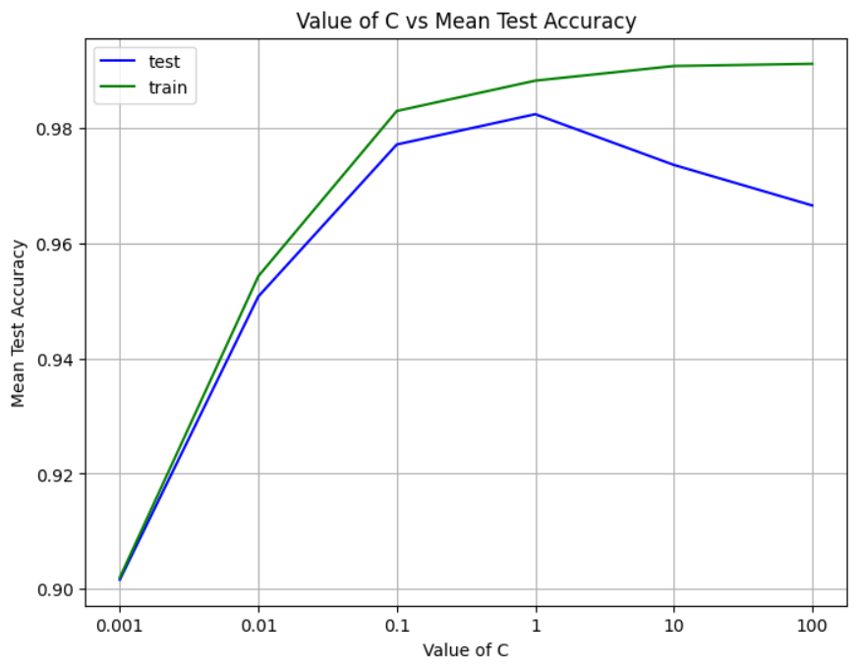
Logistic Regression
Parameter Tuning
Dataset 1
Highest Mean Test Accuracy Achieved: 0.98245614
Best C Value: 1

Slide 6
Logistic Regression
Parameter Tuning
Dataset 1 - Bias/Variance Tradeoff
A low value of C, high regularization gives low training accuracy, which means that the model has not fitted itself closely to the training data, this is low variance and high bias. As we increase C, and regularization becomes low, the model better fits the training data giving high training accuracy and also improves the testing accuracy. But when we increase C beyond the value of 1 (i.e. 10, 100) the training accuracy increases since the model has to overfit on the training data and testing accuracy decreases as a result, this causes high variance and low bias. Considering this tradeoff, we ended up choosing C=1 for our model for the best results.

Slide 7
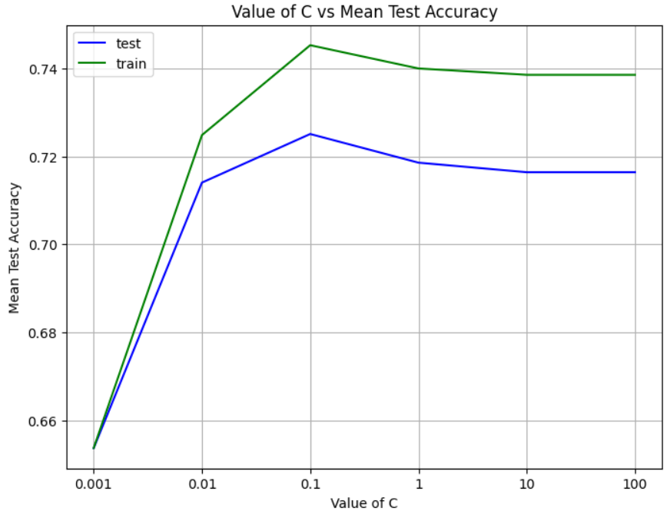
Logistic Regression
Parameter Tuning
Dataset 2
Highest Mean Test Accuracy Achieved: 0.72511563
Best C Value: 0.1

Slide 8
Logistic Regression
Parameter Tuning
Dataset 2 - Bias/Variance Tradeoff
Similarly for the second dataset, a low value of C, high regularization gives low training accuracy, which means that the model has not fitted itself closely to the training data, this is low variance and high bias. Shown in the figure, we increase C, and regularization becomes low, the model better fits the training data giving high training accuracy and also improves the testing accuracy. But when we increase C beyond the value of 0.1 (i.e. 1, 10, 100) the training accuracy decreases this behavior was unexpected, but since this resulted in low accuracy for both test and train data, the best choice was obvious. Considering this tradeoff, we ended up choosing C=0.1 for our model for the best results.

Slide 9
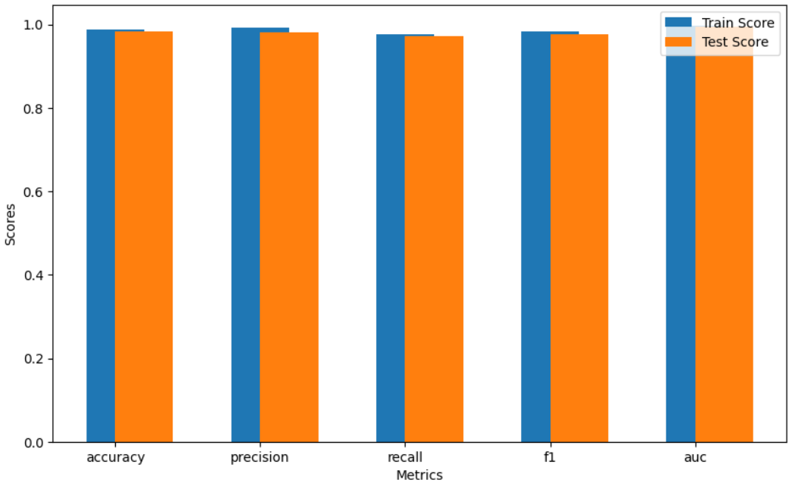
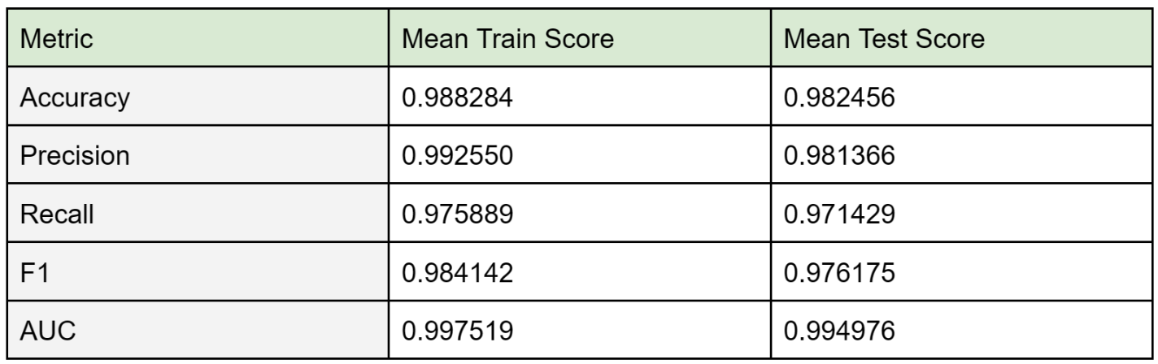
Logistic Regression
Evaluating Results
Dataset 1

Slide 10
Logistic Regression
Evaluating Results
Dataset 1 - Cross Validation Results
The difference between the training and testing scores across all metrics is insignificant, indicating a well-balanced bias-variance
tradeoff.
For each score:
Accuracy: training accuracy (0.988) is slightly higher than the testing accuracy (0.982), however the gap is not significant, indicating that it did not overfit.
Precision: both training (0.992) and testing (0.981) scores are high, where the model has a higher rate of true positives than false positives.
Recall: the gap between training (0.975) and testing (0.971) is very small, indicating that the model has generalized well.
F1 Score: F1 is influenced both by precision and recall, thus the gap of F1 score is presumably from precision scores. This again indicates the model has generalized well.
AUC: both training (0.997) and testing (0.995) scores are high, indicating the model classifies the dataset well.

Slide 11
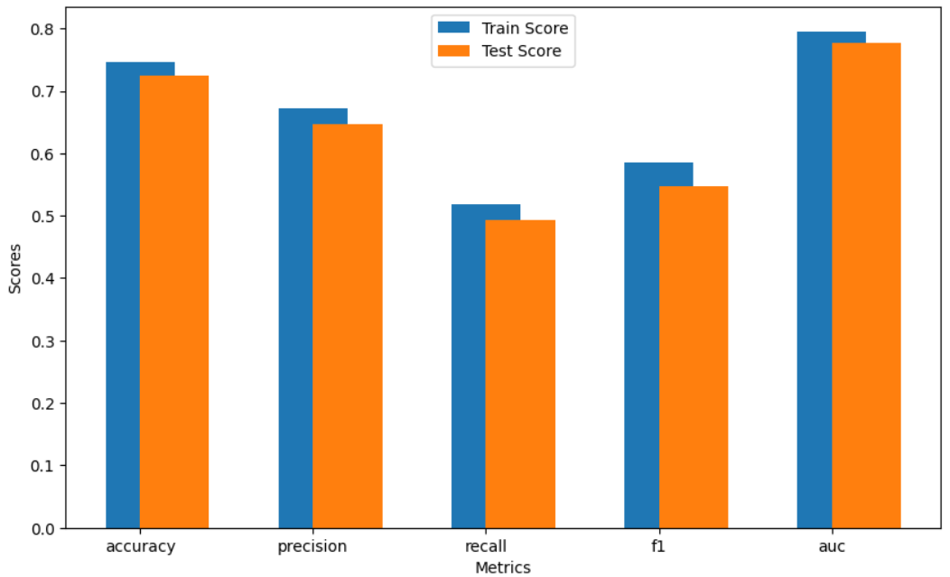
Logistic Regression
Evaluating Results
Dataset 2

Slide 12
Logistic Regression
Evaluating Results
Dataset 2 - Cross Validation Results
The difference between the training and testing scores across all metrics is relatively low, indicating a well-balanced bias-variance tradeoff.
For each score:
Accuracy: training accuracy (0.745) is slightly higher than the testing accuracy (0.725), however the gap is not significant, indicating that it did not overfit.
Precision: both training (0.672) and testing (0.648) scores are arguably good, where the model has a higher rate of true positives than false positives.
Recall: the gap between training (0.518) and testing (0.493) is small, but the values are low indicating that the model has a high rate of false negatives.
F1 Score: F1 is influenced both by precision and recall, thus the low value of F1 score is presumably from recall scores. This indicates a high rate of false positives and false negatives. This may be caused by class imbalance in the dataset.
AUC: both training (0.796) and testing (0.777) scores are high, indicating the model classifies the dataset well.

Slide 13
K Nearest Neighbor
K Nearest Neighbors (KNN) is a simple model to classify data. It trains on an already classified data, and when given a datapoint it decides the class by looking at the nearest K number of neighbors, and assigns the datapoint the majority class.
Parameter Tuning
Number of Neighbours (K) tested as hyperparameters ranged from 1 to 99.

Slide 14
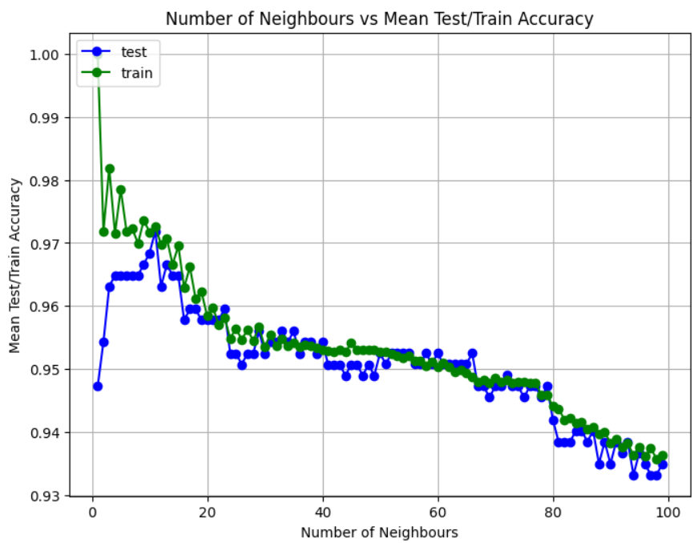
KNN
Parameter Tuning
Dataset 1
Highest Mean Test Accuracy Achieved: 0.9718984
Best K Value: 11

Slide 15
KNN
Parameter Tuning
Dataset 1 - Bias/Variance Tradeoff
With initial low values of K the model overfit on the training data, giving high mean train accuracy and low test accuracy. As we increase K to around 10, the test accuracy peaks and becomes comparable to the train accuracy, showing that the model is able to classify well. But as we keep increasing K, the accuracy for both test and train data decreases because the classification now is less influenced by local variations in the data.

Slide 16
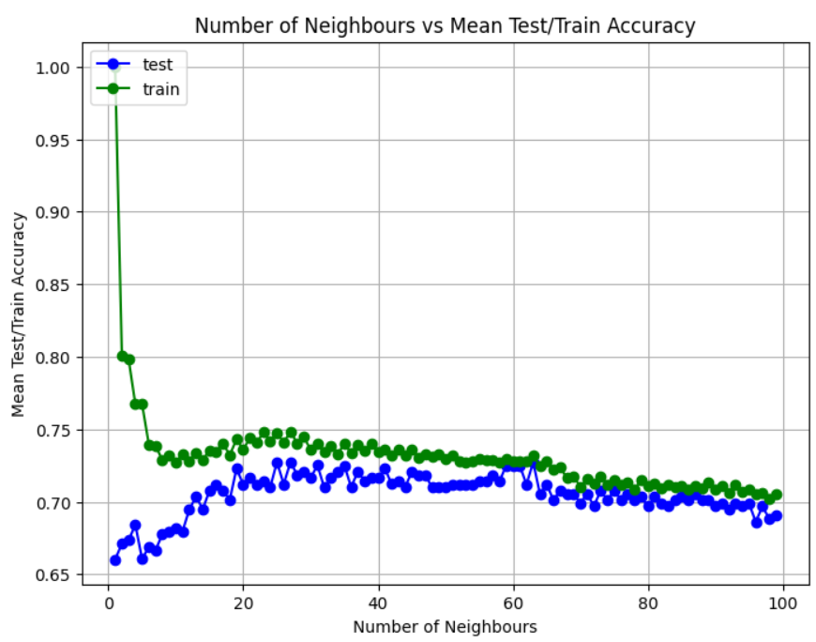
KNN
Parameter Tuning
Dataset 2
Highest Mean Test Accuracy Achieved: 0.72733580
Best K Value: 25

Slide 17
KNN
Parameter Tuning
Dataset 2 - Bias/Variance Tradeoff
Similarly for the second dataset, with initial low values of K the model overfit on the training data, giving high mean train accuracy and low test accuracy. As we increase K to around 25, the test accuracy peaks and becomes comparable to the train accuracy, showing that the model is able to classify well. But as we keep increasing K, the accuracy for both test and train data decreases because the classification now is less influenced by local variations in the data.

Slide 18
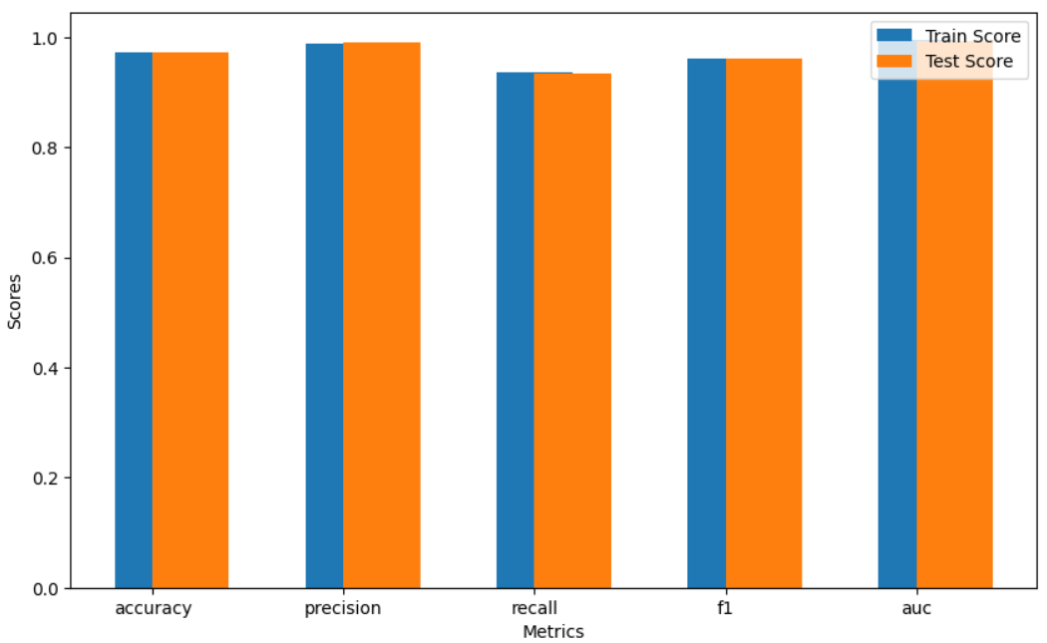
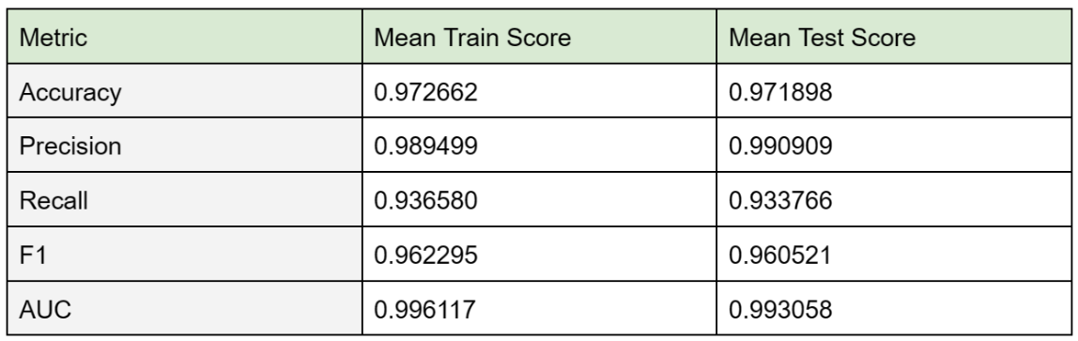
KNN
Evaluating Results
Dataset 1

Slide 19
KNN
Evaluating Results
Dataset 1 - Cross Validation Results
The difference between the training and testing scores across all metrics is insignificant, indicating a well-balanced bias-variance tradeoff.
For each score:
Accuracy: training accuracy (0.973) is very slightly higher than the testing accuracy (0.972), however the gap is not significant, indicating that it did not overfit.
Precision: both training (0.989) and testing (0.990) scores are high, where the model has a higher rate of true positives than false positives.
Recall: the gap between training (0.936) and testing (0.933) is very small, indicating that the model has generalized well.
F1 Score: F1 is influenced both by precision and recall, this again indicates the model has generalized well.
AUC: both training (0.996) and testing (0.993) scores are high, indicating the model classifies the dataset well.

Slide 20
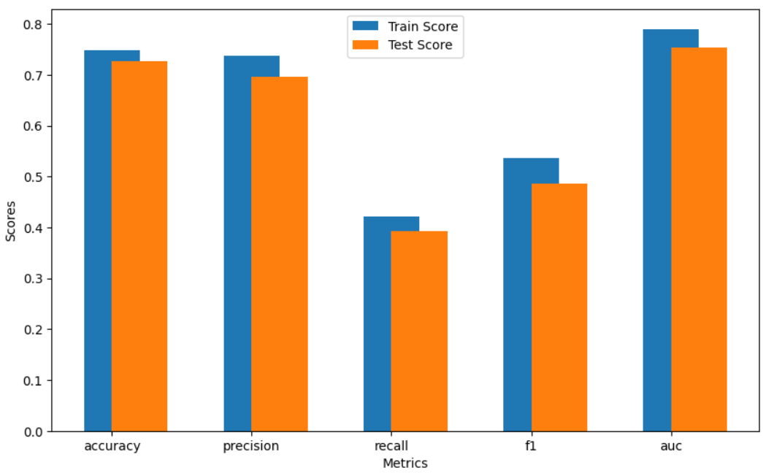
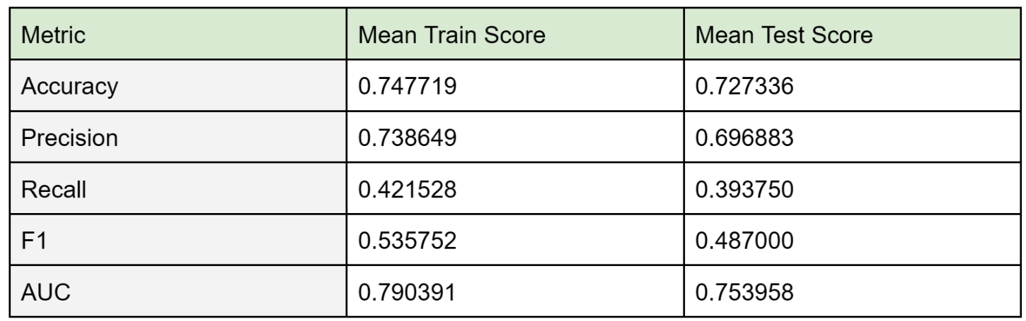
KNN
Evaluating Results
Dataset 2

Slide 21
KNN
Evaluating Results
Dataset 2 - Cross Validation Results
The difference between the training and testing scores across all metrics is relatively low, indicating a well-balanced bias-variance tradeoff.
For each score:
Accuracy: training accuracy (0.748) is slightly higher than the testing accuracy (0.727), however the gap is not significant, indicating that it did not overfit.
Precision: both training (0.739) and testing (0.697) scores are arguably high, where the model has a higher rate of true positives than false positives.
Recall: the gap between training (0.421) and testing (0.392) is small, but both the values are low indicating that the model has a high rate of false negatives
F1 Score: F1 is influenced both by precision and recall, thus the low value of F1 score is presumably from recall scores. This indicates a high rate of false positives and false negatives. This may be caused by class imbalance in the dataset.
AUC: both training (0.790) and testing (0.754) scores are high, indicating the model classifies the dataset well but because the area is slightly higher on the training set, it may be overfit.

Slide 22
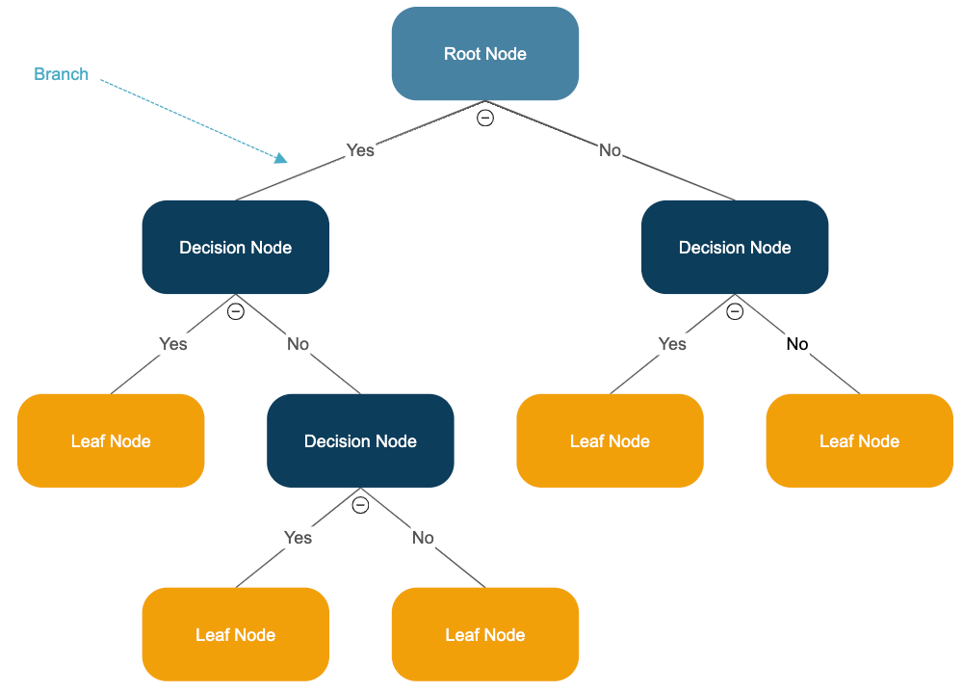
Decision Tree
Top-down, supervised algorithm
Process
Starts from root node with all data points
Goes down, repeatedly examining current leaves and possible splits
Chooses splits
Continues until reaching the last leaf node
Advantages
Simple, effective, intuitive, easy to interpret and visualize
Risks
Can lead to suboptimal trees and overfitting

Slide 23
Decision Tree
Parameter Tuning
Focused on determining optimal data splitting and stopping criteria for best results.
Gini vs Entropy
Compared two parameters for splitting data, where Gini is faster but Entropy can lead to more balanced trees by measuring node impurity and homogeneity
max_depth & min_samples_leaf
Utilized to manage the bias-variance tradeoff, aiming to prevent overfitting and complexity by controlling tree growth and the minimum samples in leaf nodes

Slide 24
Decision Tree
Parameter Tuning
Gini vs Entropy
→ Higher test accuracy in Entropy
 | Entropy | Gini
Test accuracy for Dataset 1 | 0.934962 | 0.915664
Test accuracy for Dataset 2 | 0.638575 | 0.616790

Slide 25
Decision Tree
Parameter Tuning
max_depth & min_samples_leaf
Combination of both max_depth and min_samples_leaf Looped both ranges from 1 to 20
 | max_depth | min_samples_leaf | testing accuracy
Dataset 1 Best Model | 4 | 10 | 0.942
Dataset 2 Best Model | 3 | 10 | 0.723

Slide 26
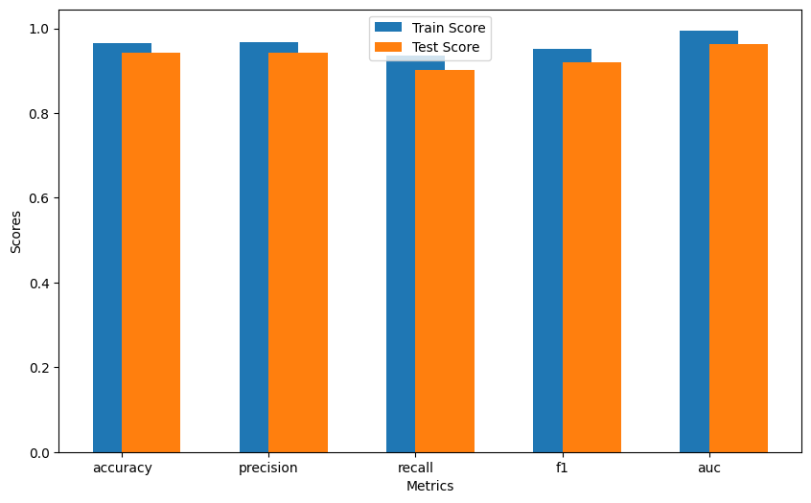
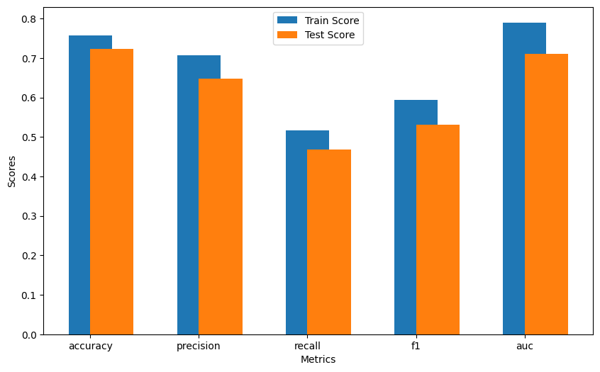
Decision Tree
Evaluating Results
Dataset 1
Dataset 2
Dataset 1: Well-balanced bias-variance tradeoff (only small difference between training and testing scores across all metrics)
Dataset 2: Potential for improvement in bias-variance tradeoff (lower overall scores and larger gaps between training and testing across all metrics)

Slide 27
SVM
Support Vector Machines are classification models that can classify data with no obvious linear separation by transforming them to a higher dimension and using a support vector classifier in that relatively higher dimension. To decide which dimension would be best to transform the feature space to, we use different Kernels. Other parameters like gamma and C also affect the classification and have been discussed in more detail in the following slides.
Parameter Tuning
Kernel: 'linear', 'poly', 'rbf', 'sigmoid' Parameter C: [0.1, 1, 10] Gamma: [0.01, 0.1, 1, 10]

Slide 28
SVM
Parameter Tuning
Kernel:
Linear: This works well when the data is linearly separable, resulting in an untransformed feature space.
Polynomial: This works well for relationships that are non-linear and can make more flexible decision boundaries, the data is transformed but no extra dimension is added.
RBF: These are even more flexible than polynomial kernels and the decision boundary complexity depends on the value of gamma, which we are also changing and testing with for this project. And so we hypothesized that this choice will probably give the best test accuracy. However, higher gamma values could lead to overfitting so we tested with a range of values. This is discussed more later in this section.This is also the default kernel in sci-kit learn.
Sigmoid: The sigmoid function is also nonlinear and the shape and flexibility of the decision boundary for this also depends on the gamma value. This also seemed like a good candidate to perform our tests due to the flexibility, but the complex boundaries that form may not be able to generalize well over the dataset.

Slide 29
SVM
Parameter Tuning
Parameter C
[0.1, 1, 10]
Large value of parameter C gives a small margin, hence penalizing more on misclassified data points. This results in Low Bias and High Variance A small value of parameter C gives a large margin, this allows for more misclassifications, resulting in High Bias and Low Variance.
Gamma (𝛾)
[0.01, 0.1, 1, 10]
We learnt in class that when 𝛾 is small, a support vector has influence on deciding the class of a data even if the distance is large.This results in High Bias and Low Variance. When 𝛾 is large, a support vector does not have widespread influence. This results in Low Bias and High Variance.

Slide 30
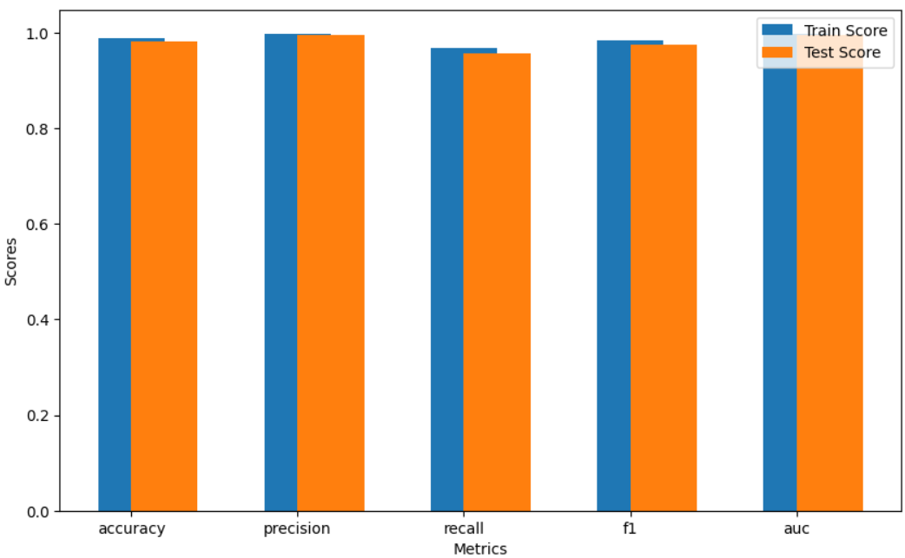
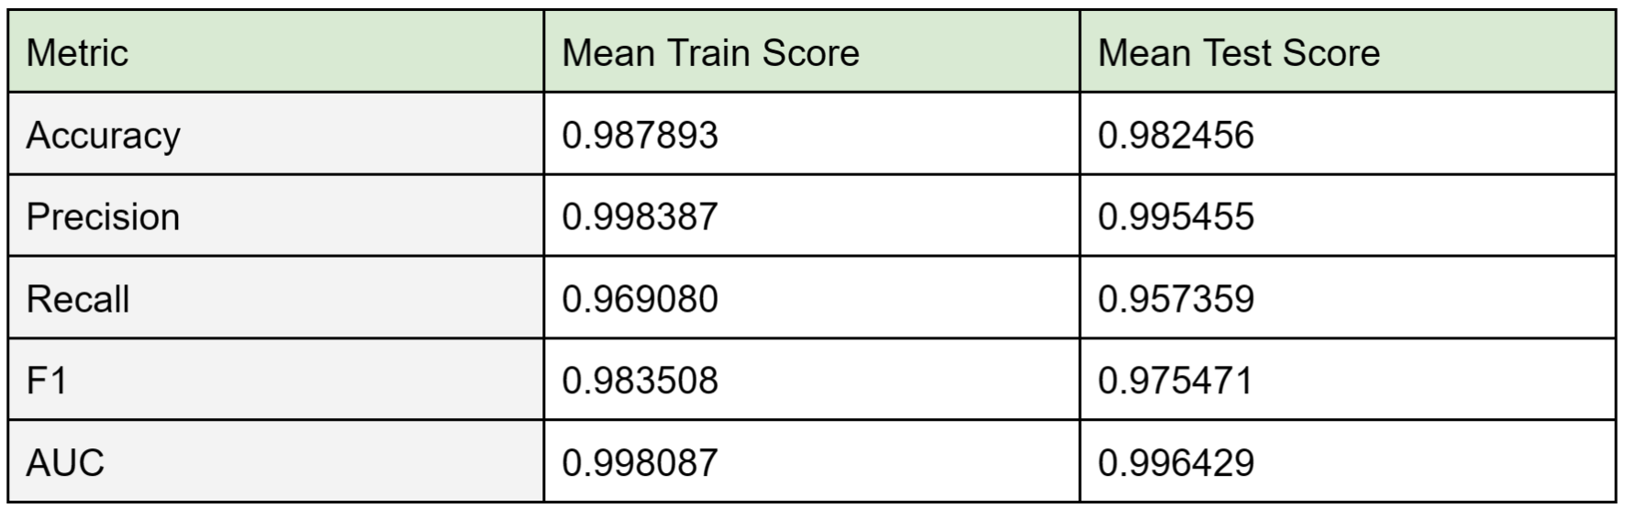
SVM
Evaluating Results
Dataset 1
Best Hyperparameters:
{'C': 10, 'gamma': 0.01, 'kernel': 'rbf'}

Slide 31
SVM
Evaluating Results
Dataset 1 - Cross Validation Results
The difference between the training and testing scores across all metrics is insignificant, indicating a well-balanced bias-variance tradeoff.
For each score:
Accuracy: training accuracy (0.987) is slightly higher than the testing accuracy (0.982), however the gap is not significant, indicating that it did not overfit.
Precision: both training (0.998) and testing (0.995) scores are high, where the model has a higher rate of true positives than false positives.
Recall: the gap between training (0.969) and testing (0.957) is very small, indicating that the model classifies the data well.
F1 Score: F1 is influenced both by precision and recall, thus the gap of F1 score is presumably from recall scores. This again indicates the model has generalized well.
AUC: both training (0.998) and testing (0.996) scores are high, indicating the model classifies the dataset well.

Slide 32
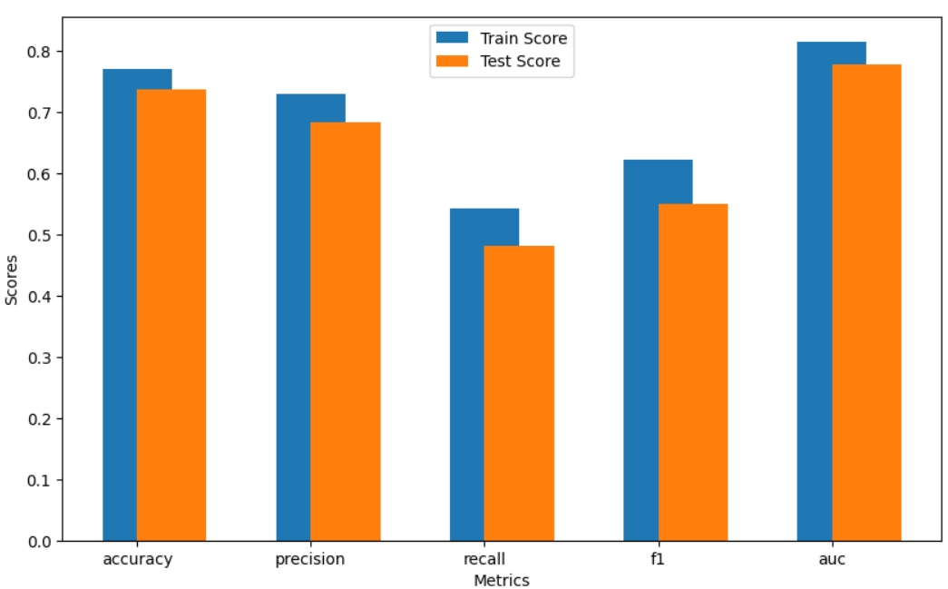
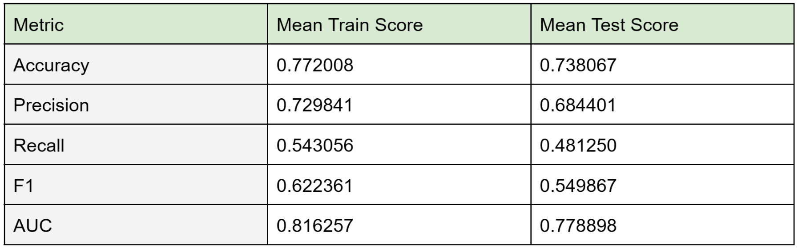
SVM
Evaluating Results
Dataset 2
Best Hyperparameters:
{'C': 10, 'gamma': 0.01, 'kernel': 'rbf'}

Slide 33
SVM
Evaluating Results
Dataset 2 - Cross Validation Results
The difference between the training and testing scores across all metrics is relatively low, indicating a well-balanced bias-variance tradeoff.
For each score:
Accuracy: training accuracy (0.772) is slightly higher than the testing accuracy (0.738), and this difference might indicate that the model might have overfit on the training data..
Precision: both training (0.730) and testing (0.684) scores are comparable and relatively low, showing the model has a moderately good rate of true positives than false positives.
Recall: the gap between training (0.543) and testing (0.481) is small, but both values are low showing that the model has a high rate of false negatives.
F1 Score: F1 is influenced both by precision and recall, thus this indicates that the model may have overfit on the training data.
AUC: both training (0.816) and testing (0.778) scores are good and comparable, indicating the model classifies the dataset relatively well.

Slide 34
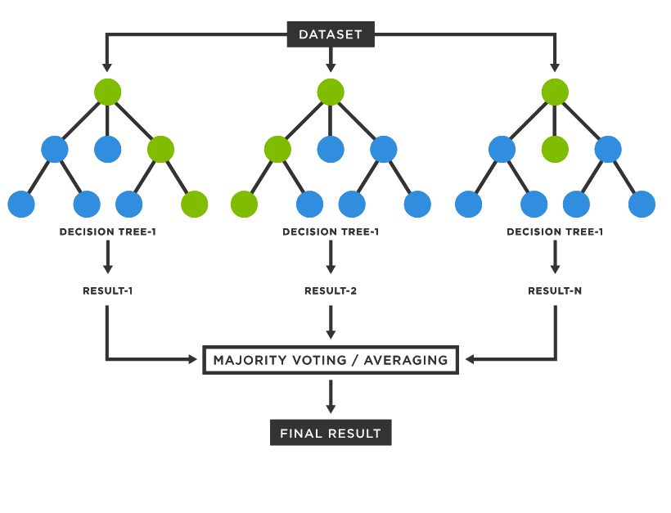
Random Forest
Combines multiple decision trees
Bagging Method
Builds each tree from a random sample of the dataset and selects a random subset of features for each tree
Majority Voting
Reduces Overfitting
not considering all features like decision tree

Slide 35
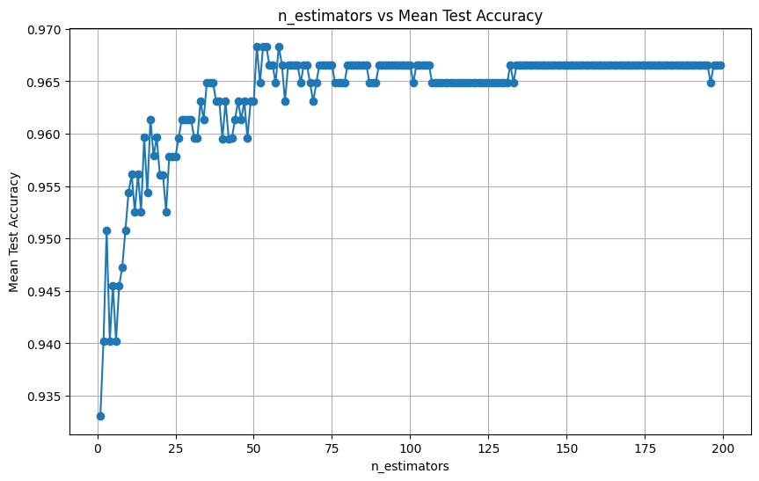
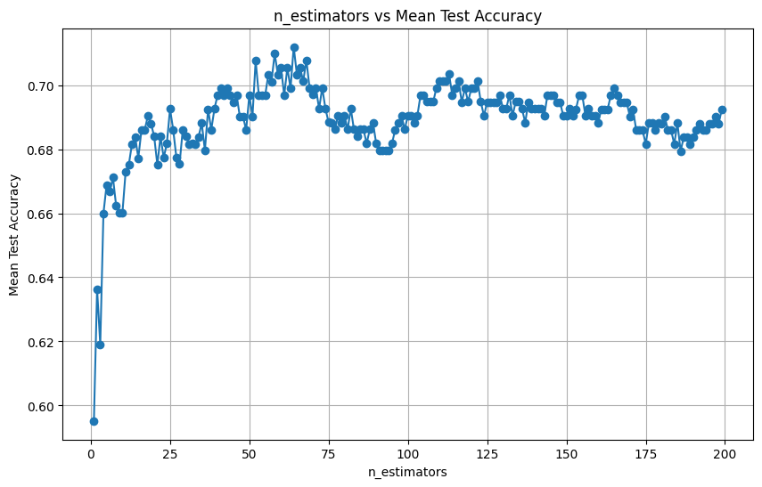
Random Forest
Parameter Tuning
n_estimator controls the number of trees, affecting accuracy and complexity
→ Initial accuracy increases, peaking at 51 (dataset 1) and 64 (dataset 2)
Dataset 1
Dataset 2

Slide 36
Random Forest
Parameter Tuning
n_estimator & max_depth
→ Optimal number of trees decreased when combined with max_depth variations, suggesting that controlled depth prevents overfitting, enhancing accuracy with fewer trees
 | max_depth | n_estimator | testing accuracy
Dataset 1 Best Model | 7 | 17 | 0.970
Dataset 2 Best Model | 3 | 38 | 0.725

Slide 37
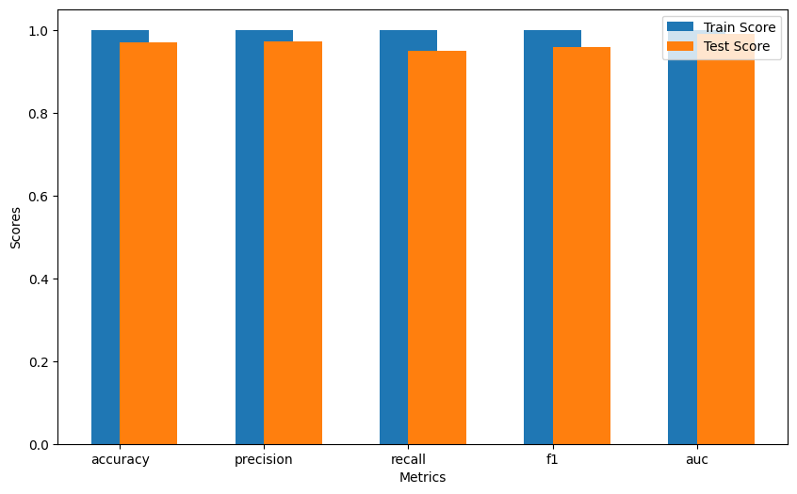
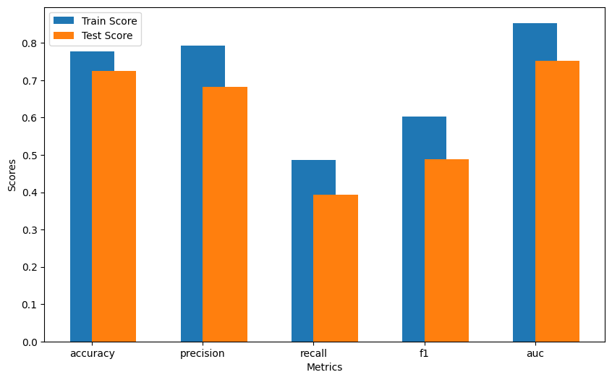
Random Forest
Evaluating Results
Dataset 1
Dataset 2
Dataset 1: Well-balanced bias-variance tradeoff (minimized gap between training and testing scores across all metrics)
Dataset 2: Potential for improvement in bias-variance tradeoff (lower overall scores and larger gaps between training and testing across all metrics)

Slide 38
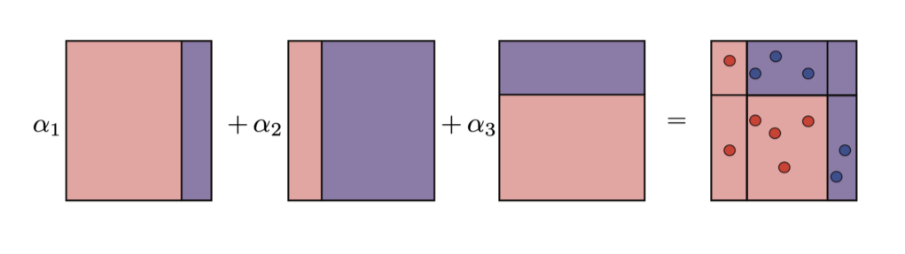
AdaBoosting
Combines multiple weak learners into a strong learner
Misclassified instances in training receive increased weights in subsequent iterations, focusing on difficult cases for improvement
Preferred for its simplicity and lower propensity for overfitting compared to XGBoost and Gradient Boosting

Slide 39
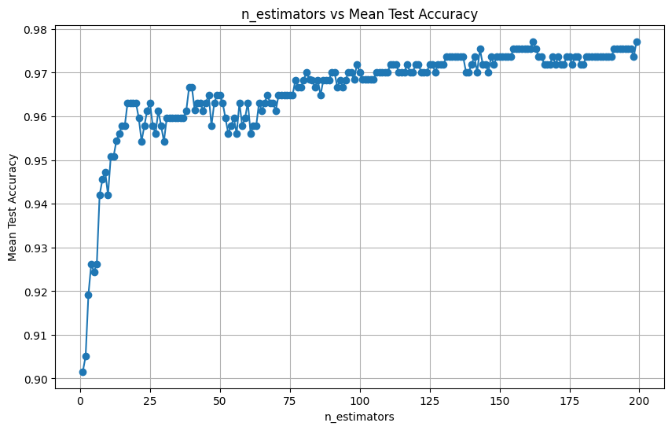
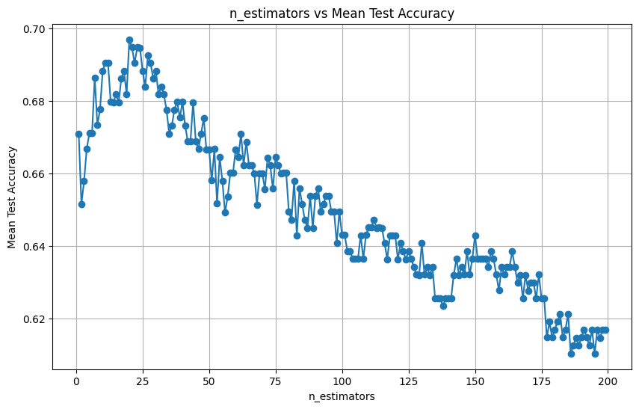
AdaBoosting
Parameter Tuning
n_estimator controls maximum number of weak learners, balancing overfitting risks
→ Initial accuracy increases, peaking at 162 for dataset 1 → Optimal at 20 for dataset 2, accuracy declining beyond this point, suggesting overfitting and high variance (may be due to inherent simplicity of dataset 2)
Dataset 1
Dataset 2

Slide 40
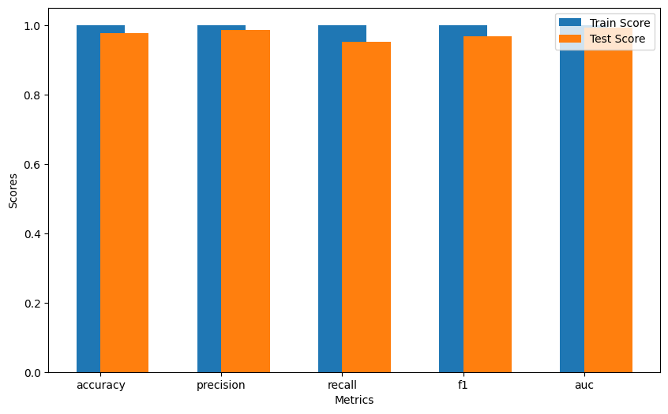
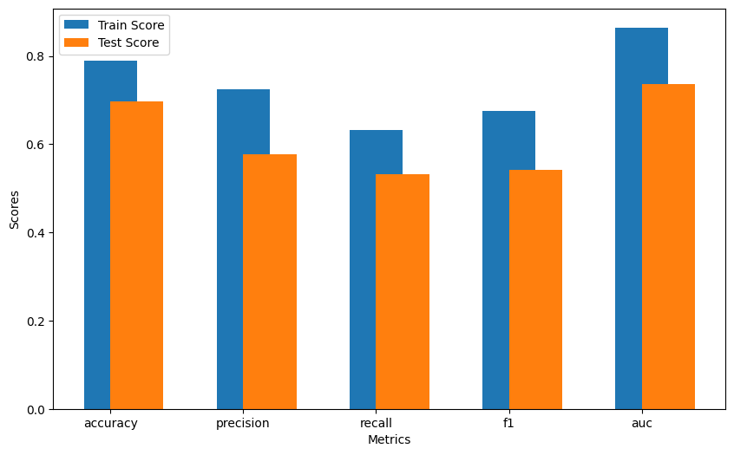
AdaBoosting
Evaluating Results
Dataset 1
Dataset 2
Dataset 1: Well-balanced bias-variance tradeoff (perfect training scores, minimized gap between training and testing scores across all metrics)
Dataset 2: Potential for improvement in bias-variance tradeoff (lower overall scores and significant gaps between training and testing across all metrics)

Slide 41
Neural Network
Structure (used Pytorch):
Contains 2 hidden layers
torch.nn.Linear was used between all layers
torch.nn.functional.Sigmoid was used as the sigmoid activation function
During training, torch.nn.CrossEntropyLoss was used to calculate loss; of note, torch.nn.CrossEntropyLoss also applies the softmax output layer
Hyperparameters (With Default Settings): | Options (Ranges):
h_1_o_s=256 | [256, 392]
h_2_o_s=128 | [128, 196]
w=None | [None, ["hidden_1"], ["hidden_2"], ["hidden_1", "hidden_2"]]
b=[1, 1] | [[1, 1], [1, 0], [0, 1], [0, 0]]
lr=0.5 | [0.25, 0.5, 0.75]

Slide 42
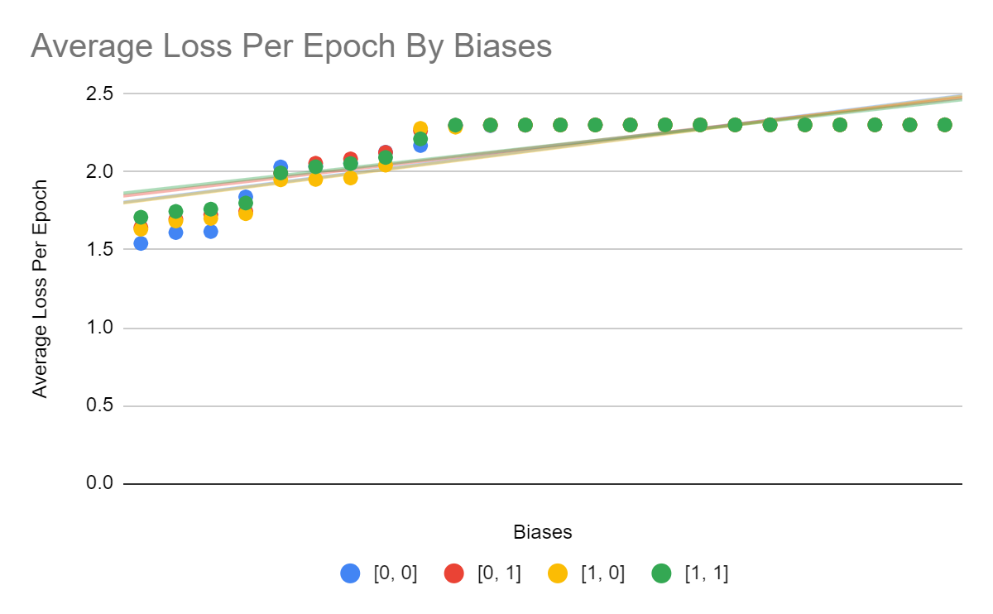
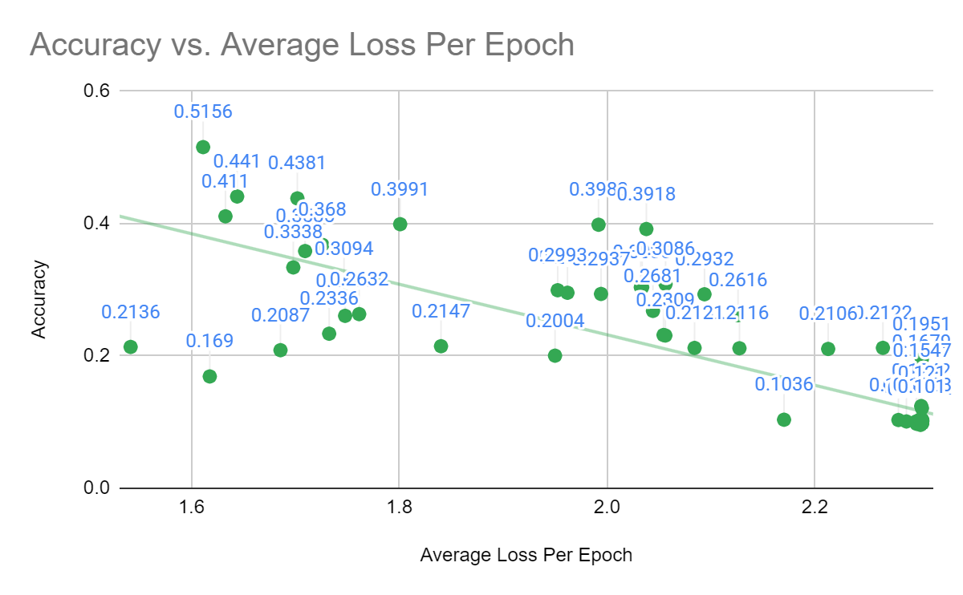
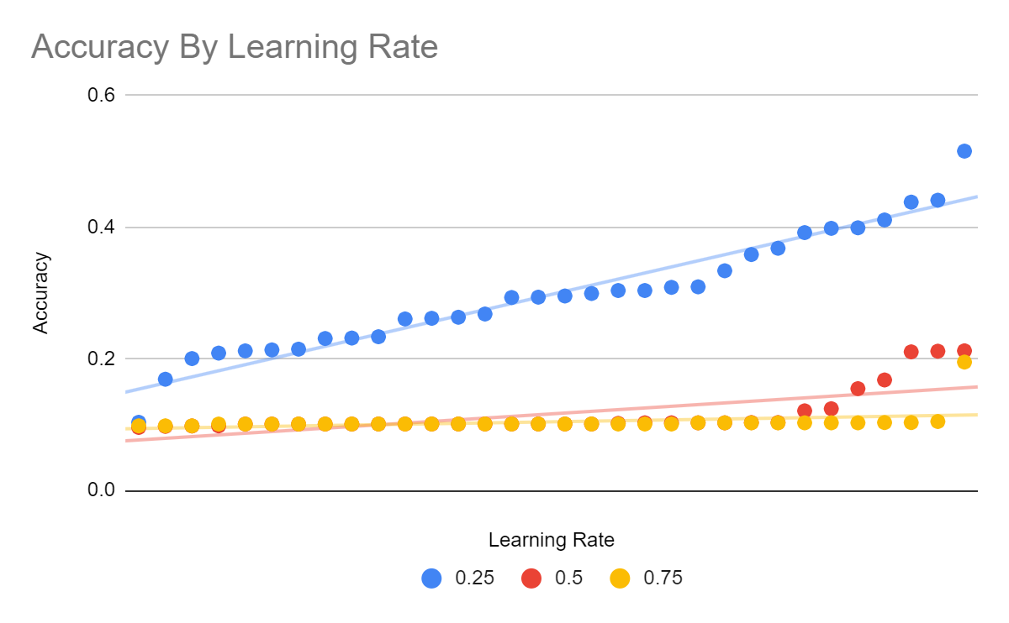
Neural Network
Hyperparameter Affects:
Learning Rate: Strongly affects training and testing performance
Number of Hidden Units: Affects training and testing performance
Weight Initialization: Does not affect training performance, does affect testing performance
Bias Initialization: Does not affect training or testing performance
Sample Graphs From Results
Highest Accuracy Model (51.56%): Learning Rate = 0.25 Number of Hidden Units = (256, 128) Weight Initialization = (xavier_normal_, default) Bias Initialization = [0, 0]

Slide 43
Thank you!
We have all learned a lot throughout this Machine Learning course, and we thank the professors and teaching assistants for everything they’ve done to facilitate our learning. This project has taught us a lot – it is often said the best way to learn is to do, and this project allowed us to implement so many of the algorithms and concepts we learned throughout the course. Happy J-term!

